Slide 1
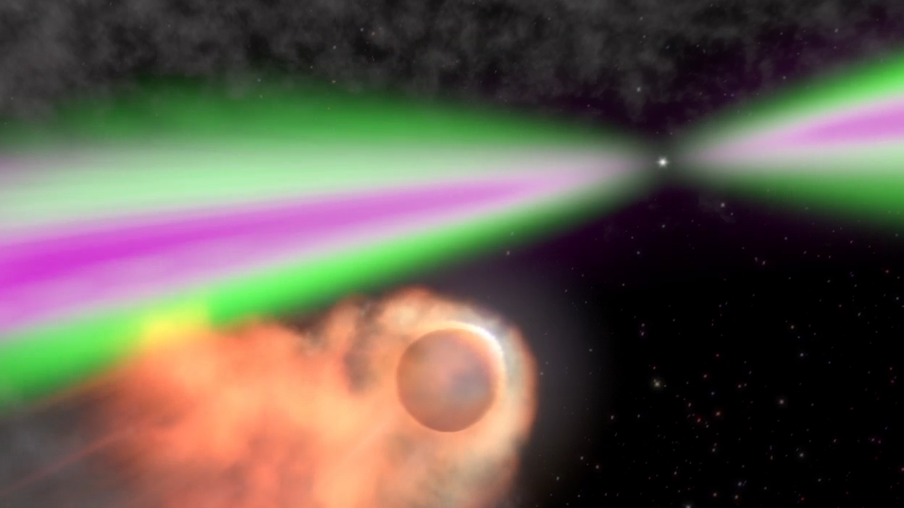
Acceleration and Emission from Shocks in Millisecond Pulsar Binaries
Alice K. Harding
NASA Goddard Space Flight Center
Zorawar Wadiasingh, Christo Venter, Marcus Bottcher
North-West University
Potchefstroom, S. Africa
Notes:
Black widow systems contain stars that are both physically smaller and of much lower mass than those found in redbacks.

Slide 2
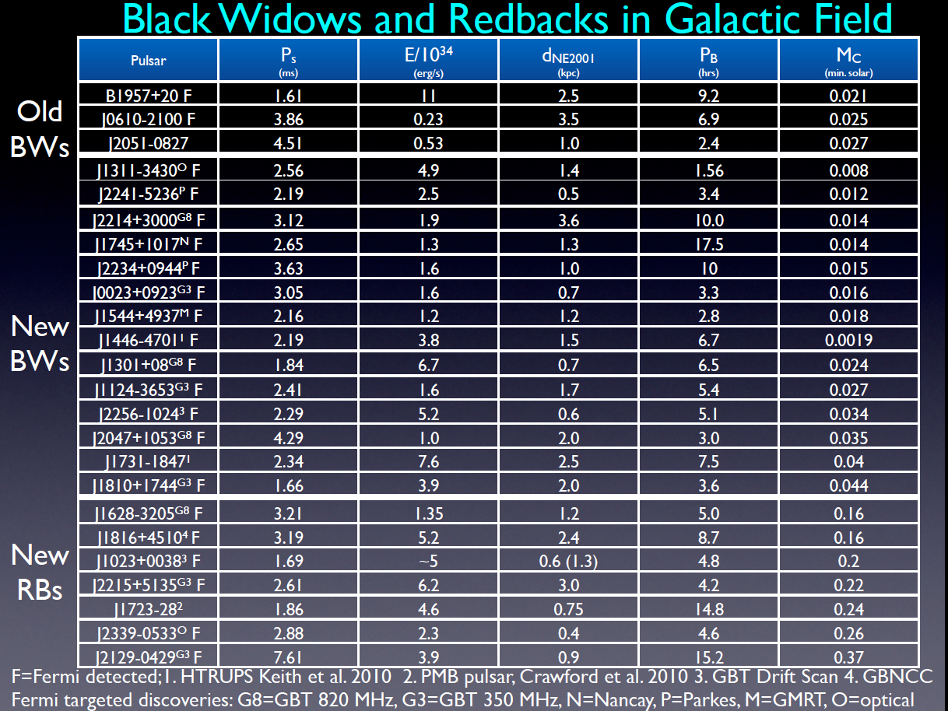
Credit:
M. Roberts

Slide 3
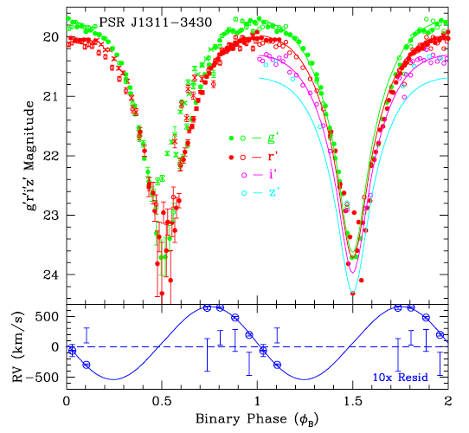
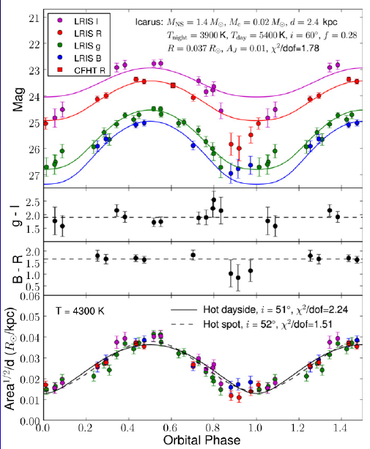
Optical observations of the stellar companion
Optical light curve modeling can constrain orbital inclination and mass ratio
Companion temperature as high as few times 10⁴ K on heated side
J1544+4937 – Tang et al. 2014
Romani et al. 2012

Slide 4
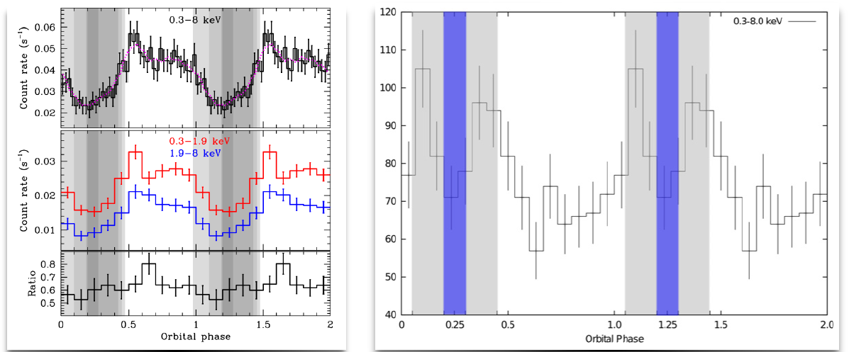
X-ray orbital modulation
Soft X-ray observations of many black widows and redbacks show a flux minimum around superior conjunction and some exhibit double-peaked light curves
Spectral indices Γ ~ 1 - 1.5, implying hard electron distributions
Emission is likely due to synchrotron, modulated by Doppler boosting and/or shadowing by companion
J1023+0038 (Bognadov et al. 2011)
B1957+20 (Huang et al. 2012)

Slide 5
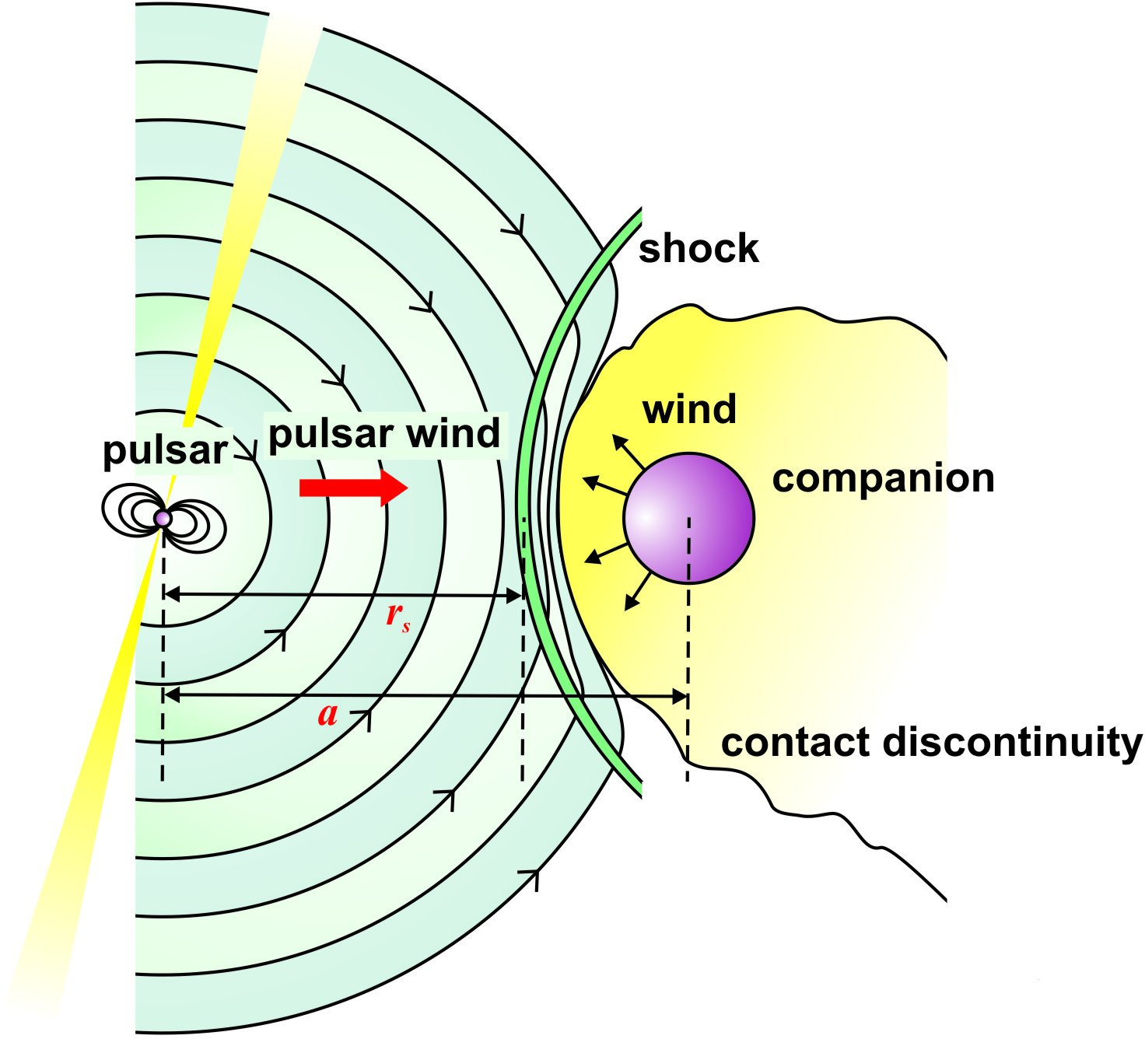
Particle acceleration at binary shock
Venter et al. 2014
Shock acceleration spectrum
Maximum acceleration energy
(Harding & Gaisser 1990)
Normalization
Pair multiplicity
Polar cap flux
Efficiency

Slide 6
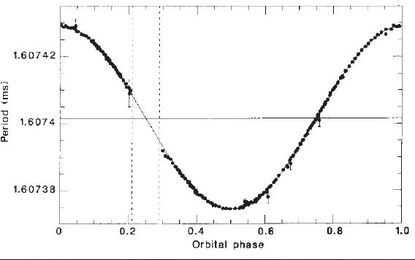
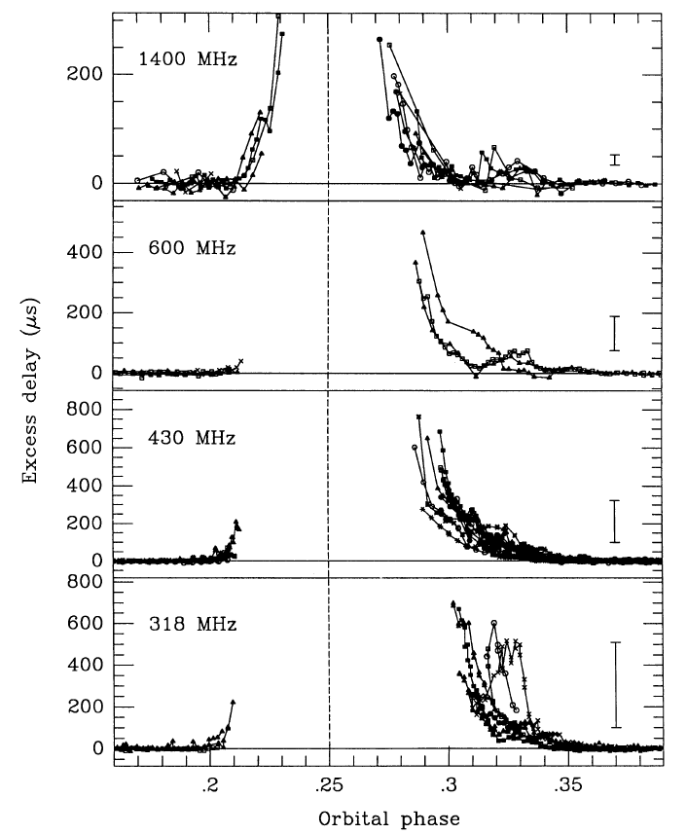
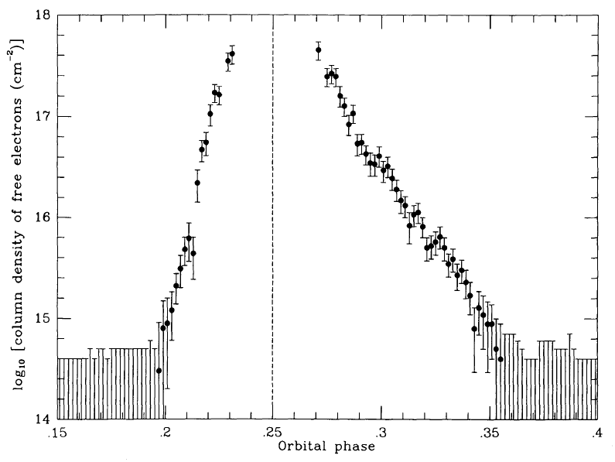
Radio Eclipses
B1957+20
Most black widows and redbacks show frequency-dependent radio eclipses over ~6-50% of their orbit, at superior conjunction
Ryba & Taylor 1991

Slide 7
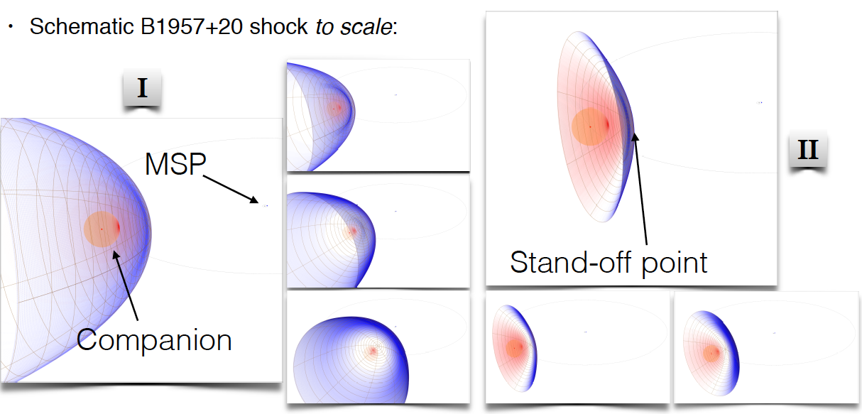
Radio eclipses by intra-binary shocks
Radio eclipses may be due to pulse smearing by scattering, dispersion or free-free absorption by turbulent plasma near intra-binary shock
We use two models for bow shock geometry: Type I – parallel wind (Wilkin et al. 1996), Type II – spherical winds (Canto et al. 1996), preferred for redbacks

Slide 8
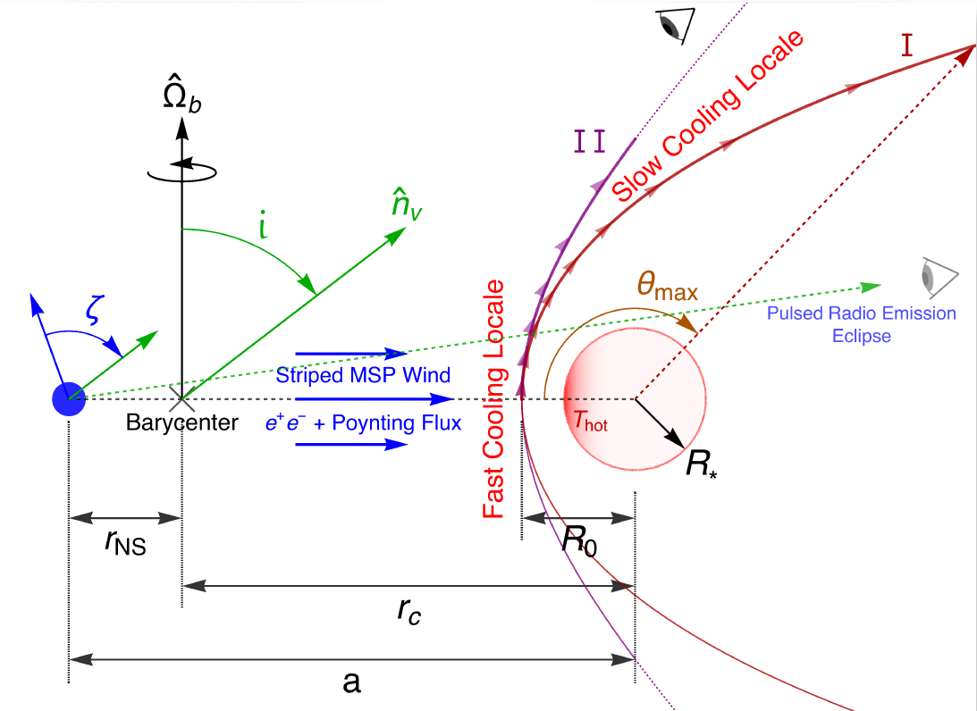
Black widow and redback binaries

Slide 9
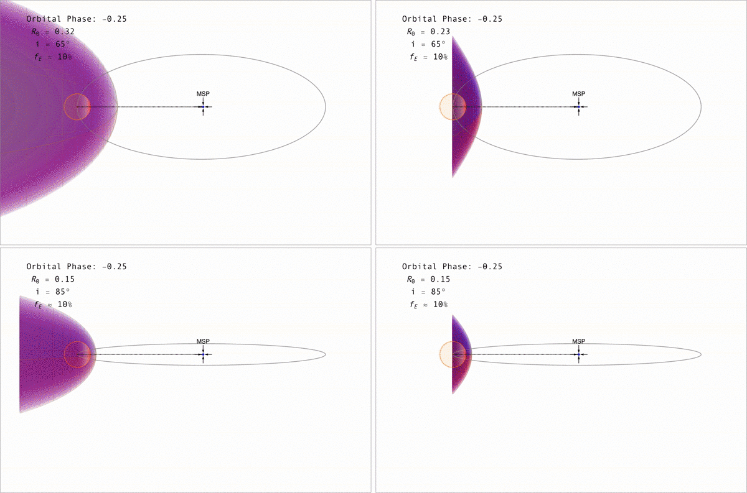

Slide 10
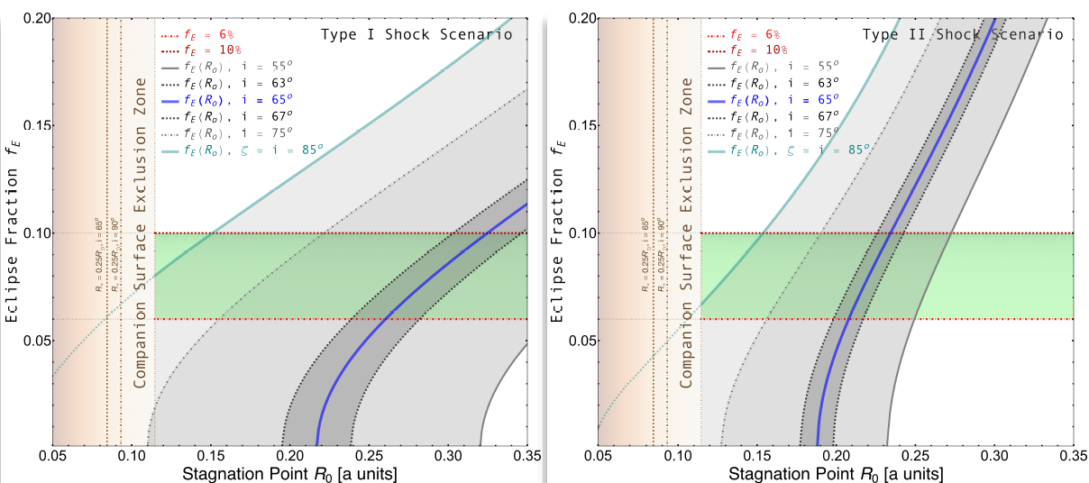
Radio eclipses by intra-binary shocks
1-to-1 correspondence between eclipse fraction and orbital inclination i for a shock with standoff distance R
B1957+20: 6 – 10% eclipse fraction (green band)
Blue line: i = 65⁰ 2⁰ (Reynolds et al. 2007), light green line: i ~ 85⁰ (Johnson et al. 2014)

Slide 11
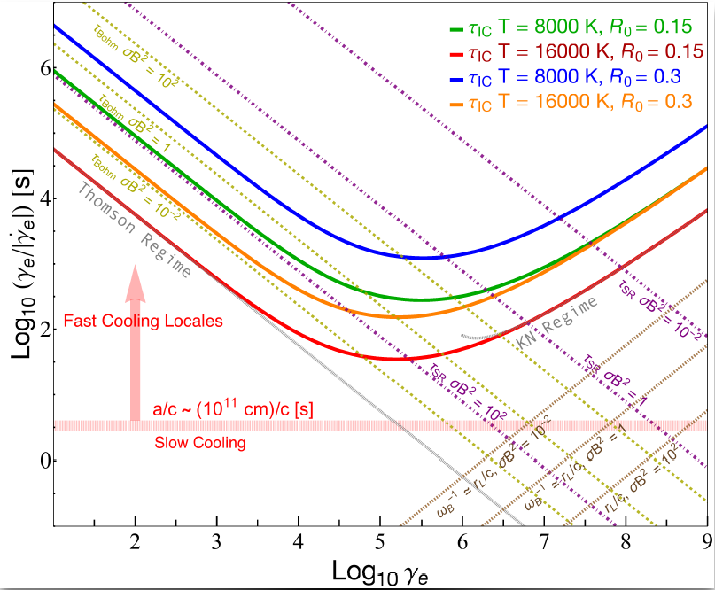
Electron timescales in the shock
IC cooling τ_{IC} and
synchrotron cooling τ_{SR} timescales computed at stagnation point
Fastest timescale is spatial convection a/c
and τ_{SR}
Electrons up to ~TeV

Slide 12
Simplified synchrotron model
Assume power-law spectrum of electrons acceleration at shock with index p = 2 and high energy cutoff E_{max,} isotropic in bulk-flow frame
Assume emission along thin shock surface with constant B field
Bulk flow downstream of shock is mildly relativistic increasing linearly from stagnation point to β_{c} = 0.5c = 0.9c.
Isotropic SR is doppler boosted at each orbital phase corresponding to a point along the shock with computed observer angle relative to shock flow
Two forms assumed for electron surface density Σ(θ):
1) constant along shock 2) maximum at stagnation point and decreases to zero

Slide 13
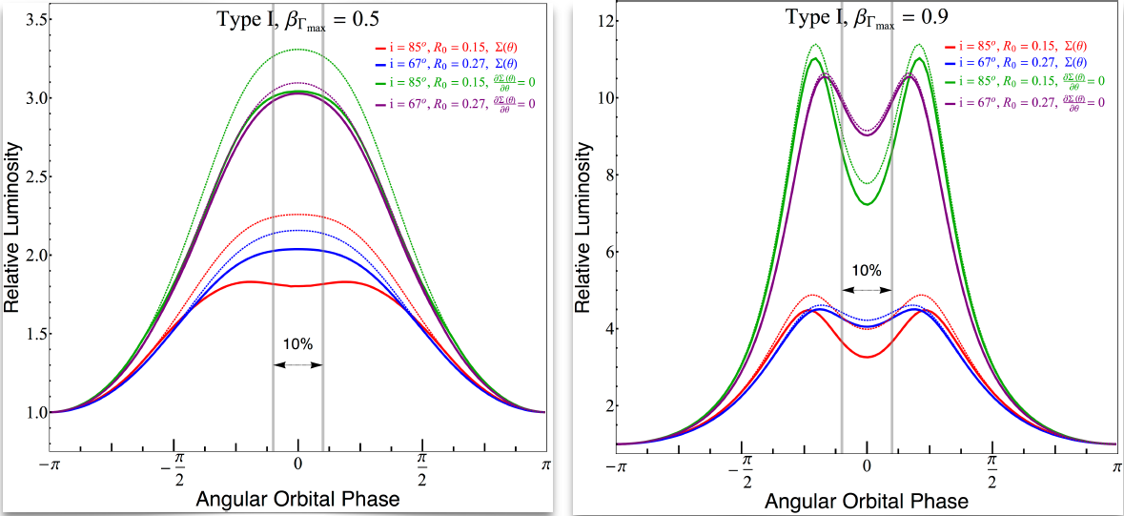
Orbitally modulated synchrotron emission
Type I shocks (B1957+20):
Doppler boosting produces a double-peaked light curve for high bulk flow velocity
Shadowing significant for R₀ close to companion
Shadowed
Unshadowed

Slide 14
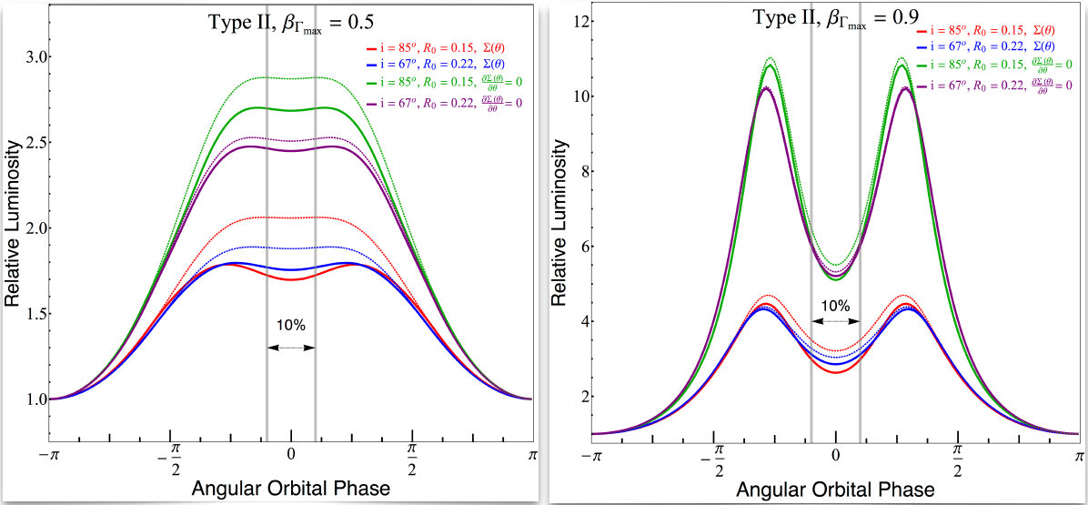
Orbitally modulated synchrotron emission
Type II shocks (B1957+20):
Complex interplay between shock shape, R0, shadowing, bulk velocity and density along the shock controls the light curve modulation
Type II shock geometry yields higher modulation and more peak separation
Shadowed
Unshadowed

Slide 15
Summary
A large fraction are γ-ray pulsars discovered by Fermi – many MSPs, redbacks and black widows
Radio eclipses can be used to constrain the geometry of intrabinary shock, critical to modeling the high energy emission
Electrons accelerated to few TeV at shock
Doppler boosting of synchrotron emission produces double-peaked light curve seen in black widow binaries
γ-γ absorption by optical-UV radiation from the companion is minor
Next: Steady-state particle transport, orbitally modulated IC emission, spectra and more. Stay tuned!
Notes:
Are emission gaps inside closed field boundary?

